Slide 1
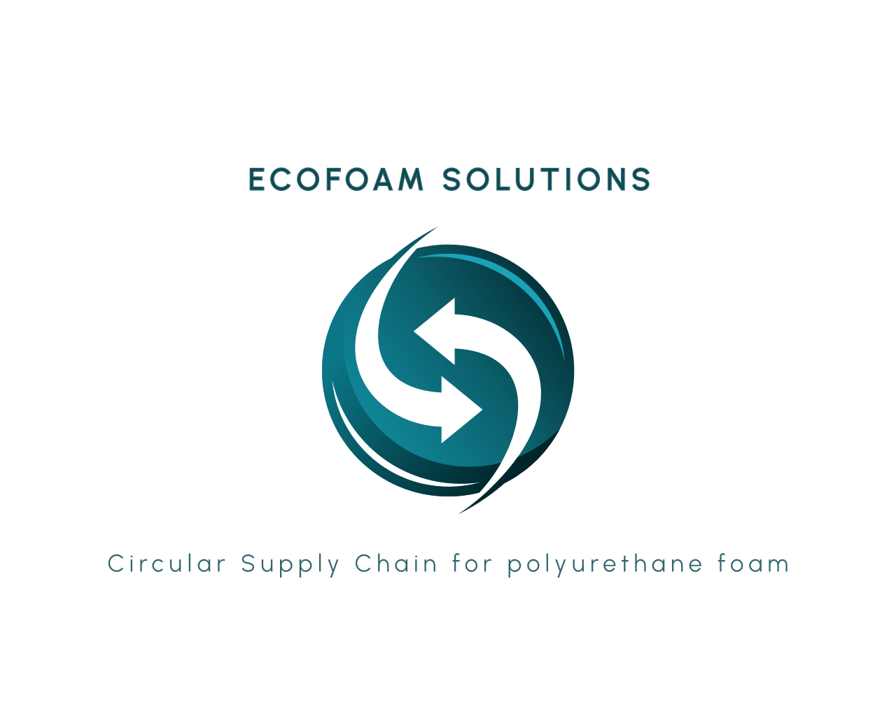
Automotive
Footwear
Raw Materials
PCW
Mattress
Rebonded Foam
Industrial
Manufacturing
PCW
Furniture
Recycled
TPU
PIW
Trimfoam
Sealing &
Gasketing

Slide 3
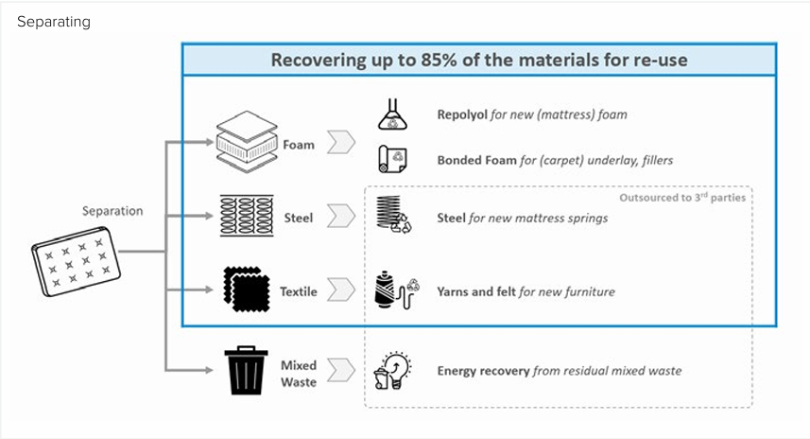

Slide 4
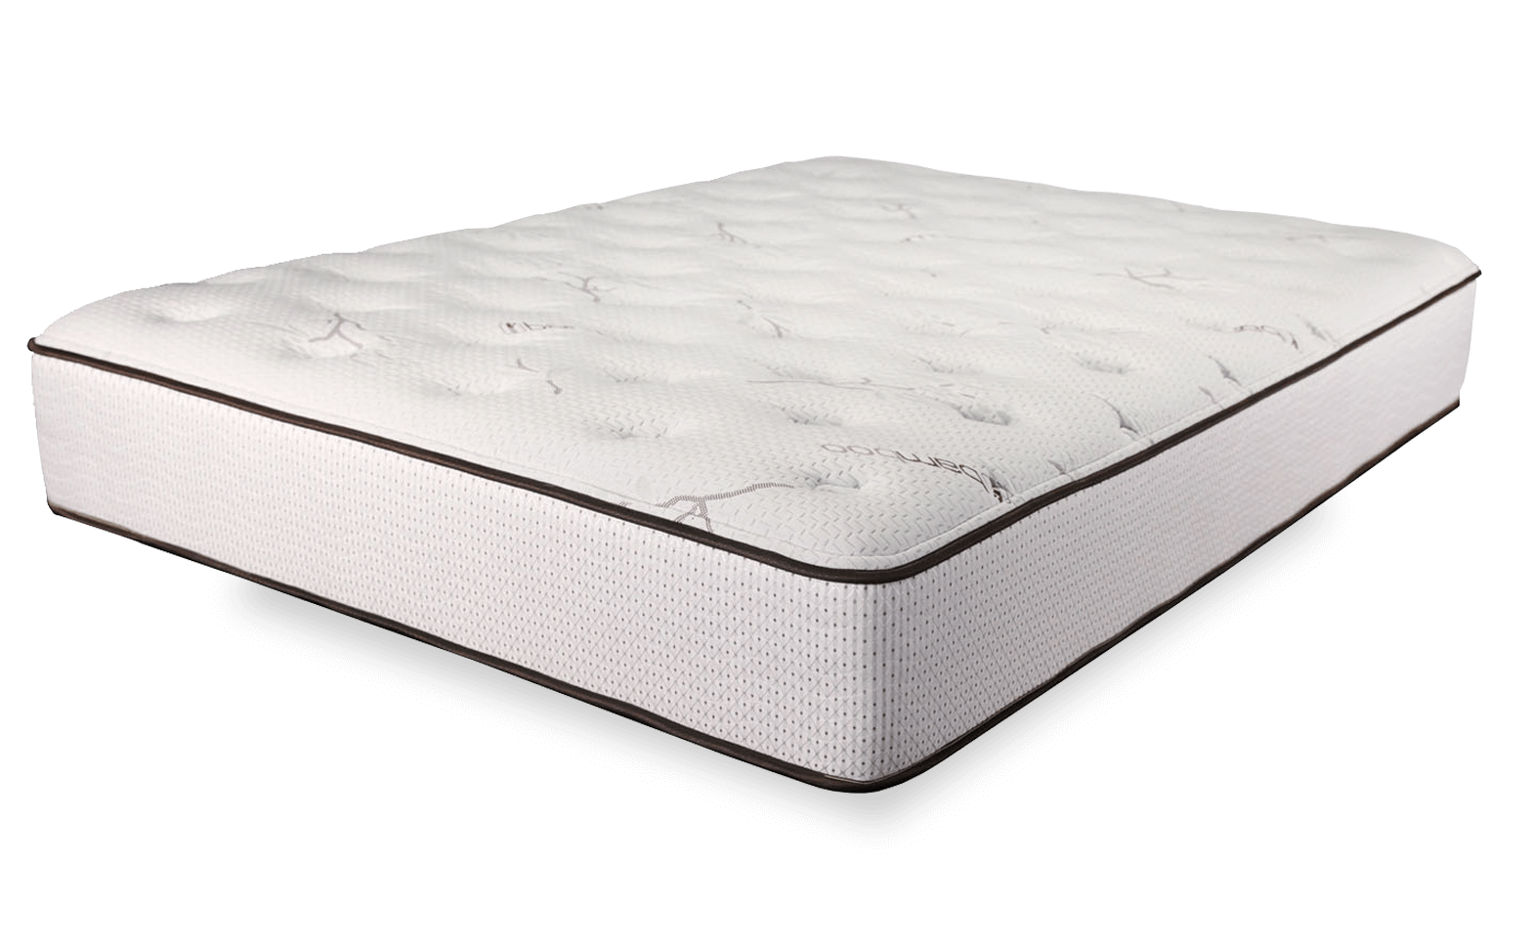
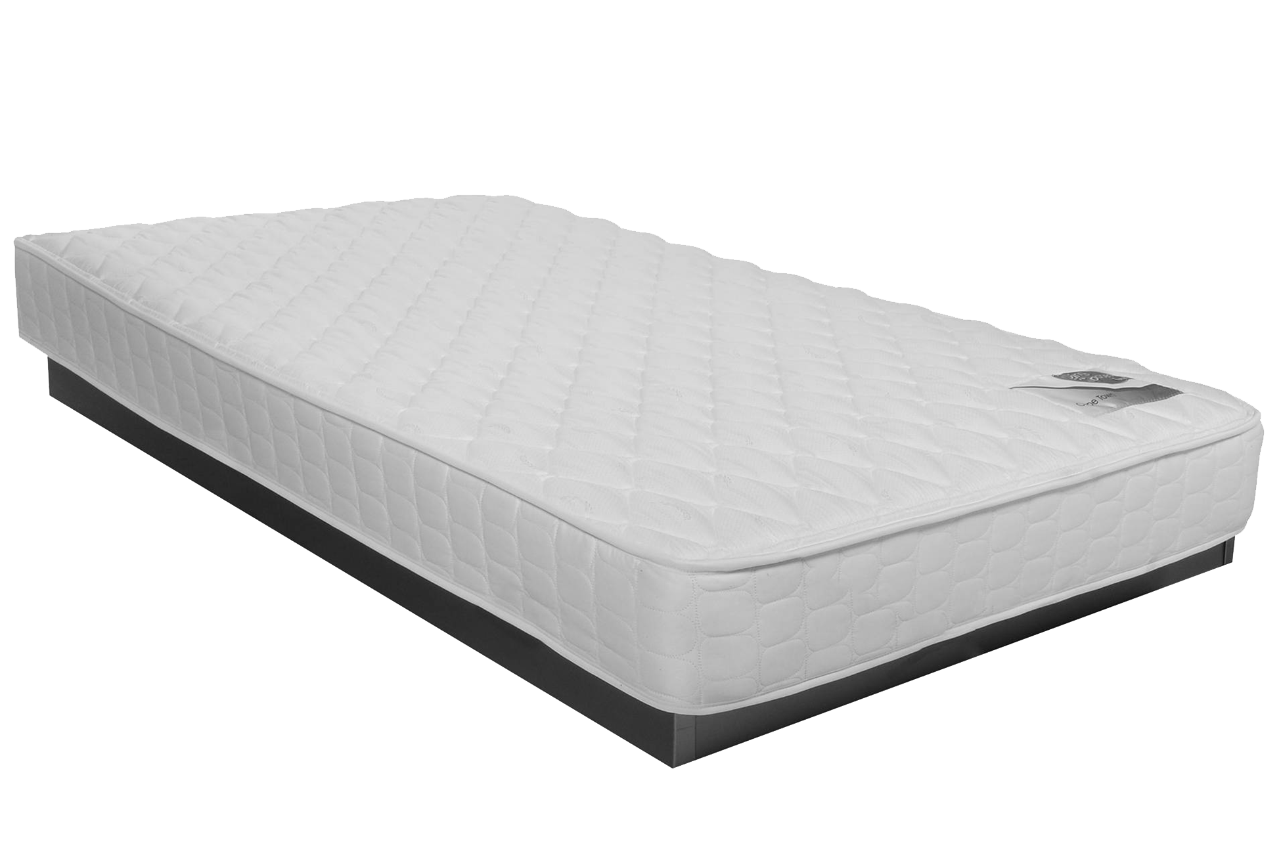

Mattress Rejuvenation
Used
EcoFoam Solutions
Inspection
Rejuvenated/
Refurbished
Replace Textile
Repair
Replace Foam
Rollpack & Box
Replace Spring
Packaging
PE packed
Shipping

Slide 5
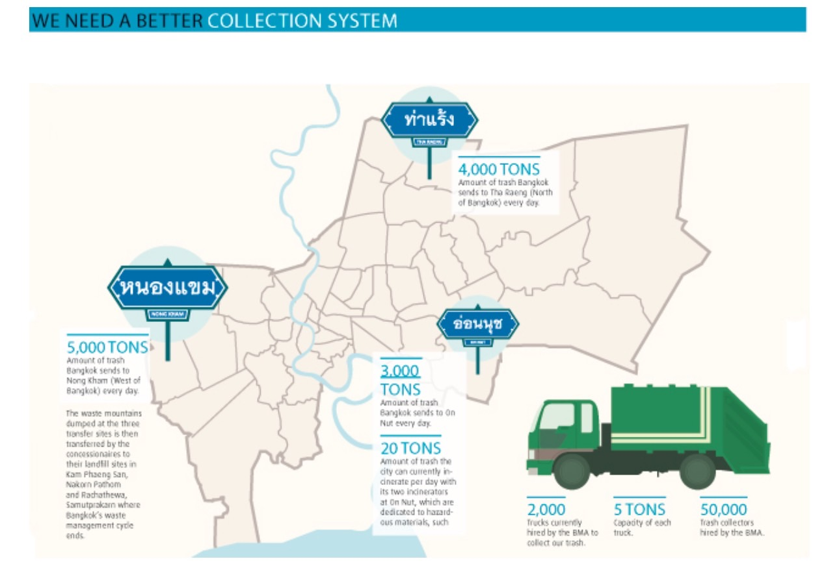

Slide 6
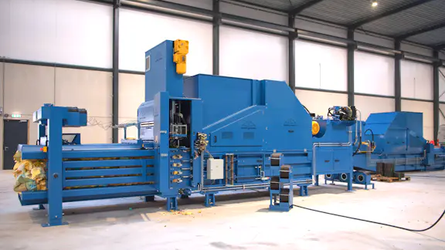

Slide 7
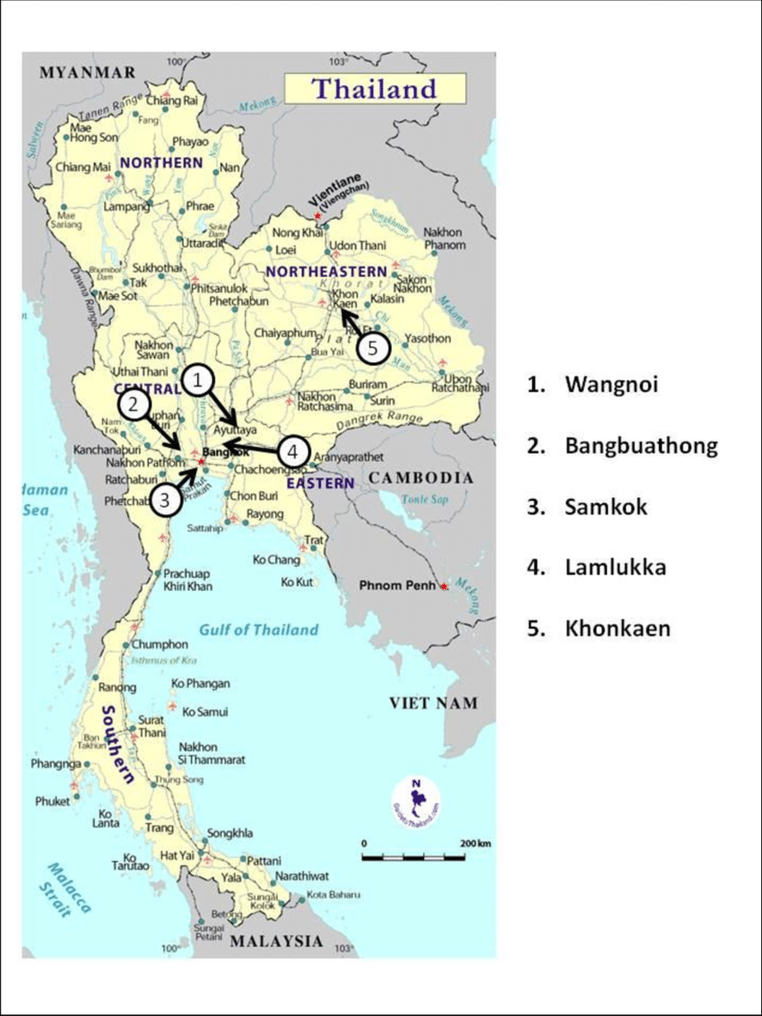

Slide 8
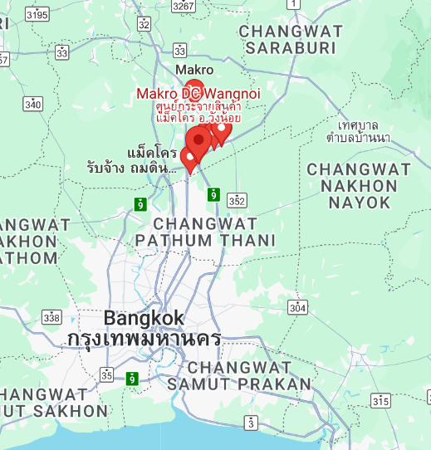
Wang Noi
DC area of:
Homepro
Lotus
Makro
Big C

Slide 9
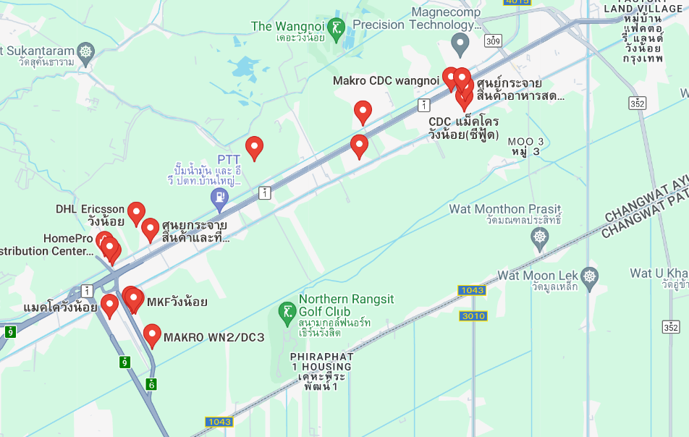

Slide 10

PU Foam Producer
Mattress Manufacturer
Retail/Online Channel
Consumer
Collection/Return
Dismantle & Sort
Recycle/Upcycle
Chemical Producer
Metal Recycling
Textile Recycling
Circular
PU Foam
Supply
Chain
EcoFoam Solutions
Strategic
Partners
PCW Source

Slide 11
PU Foam Producer
Mattress Manufacturer
Retail/Online Channel
Consumer
Collection/Return
Dismantle & Sort
Recycle/Upcycle
Chemical Producer
Circular
Mattress
Supply
Chain

Slide 12
PU Foam Producer
PU Products Manufacturer
PIW
Collection/Return
Recycle/Upcycle
TPU Users
Circular
Supply
Chain

Slide 13


Slide 14
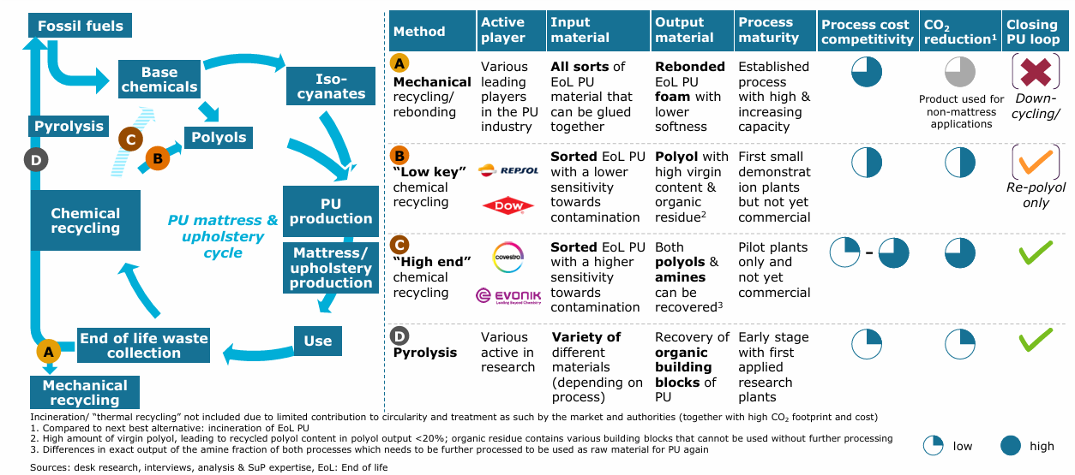

Slide 15
